Slide 1

Loan Prediction Using Machine Learning
Tanushree Mahadani

Slide 2

Introduction
Many people are applying for loans in bank. All these loans are not approvable. Loans are the core business of banks. The main profit comes directly from the loan’s interest.
The main objective of banks is to invest their assets in safe customers. Up to now many banks are processing loans after regress process of verification and validation.
But till now no bank can give surety that the customer who is chosen for loan application is safe or not.
So to avoid this situation I introduced a system for the approval of bank loans known as “Loan Prediction System” Using Python.

Slide 3
Problem Statement
Intensive time Consumption process of verification and validation.
Human errors can be introduced during the validation process.
No cross referencing previous loan records.
Lots of human resource required.

Slide 4
Problem Solution
My Machine learning model calculates all the parameters given and predicts if the applicant is eligible for loan or not in very less time.
Time required for verification and validation reduces significantly.

Slide 5

Aim and objective of the Project
To make the process of loan approval easy using fewer resources and human resources.
To make the web-app which can be accessible by anyone on the internet without downloading any desktop software.
To make the prediction model which will make the accurate predictions and help banks to make approving the loans very easy.

Slide 6

Problem Formulations
Loan_ID
Gender- Male or Female
Married- Whether the applicant is married or unmarried
Dependents- How many dependents does applicant have
Education- Whether the applicant is graduate or non graduate
Self-employed- Whether he/she is self employed or not
Applicant Income
Co-applicant Income
Loan Amount
Loan_Amount_Term
Credit_History
Property_Area
Loan_Status

Slide 7
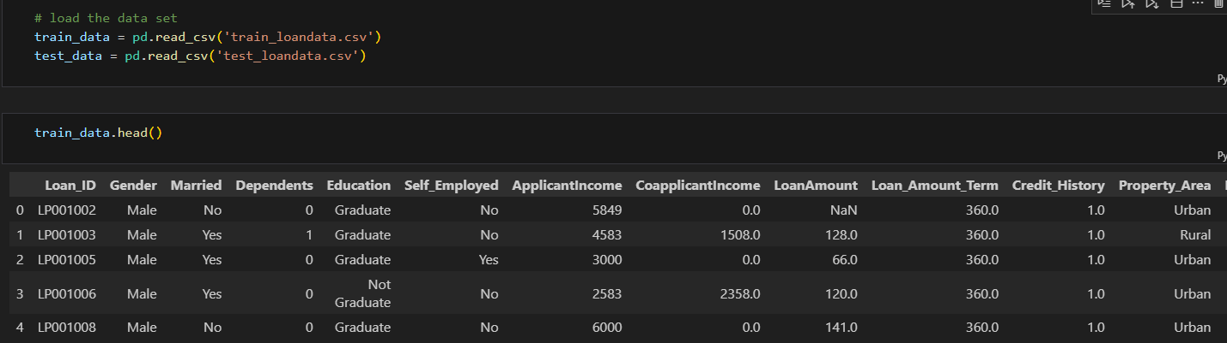
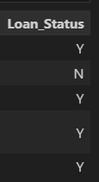
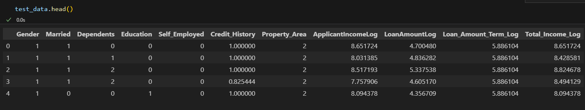
Data Loading & Manipulation

Slide 8
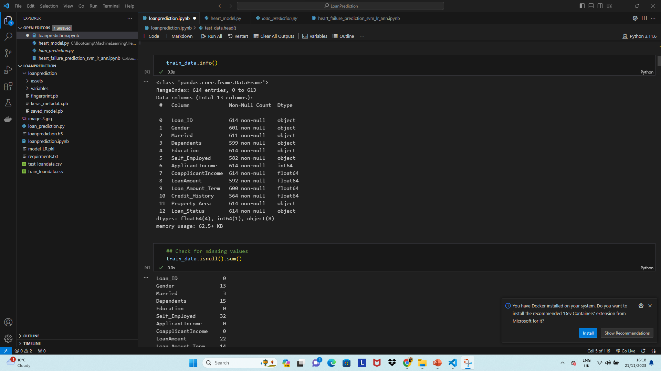
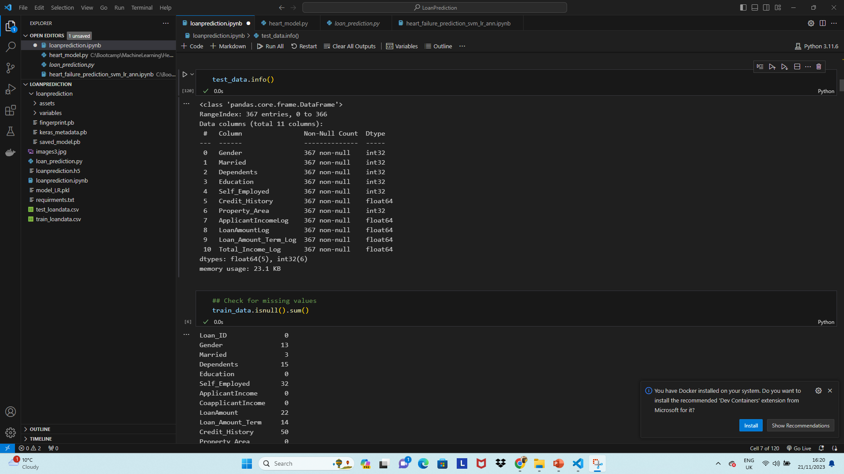
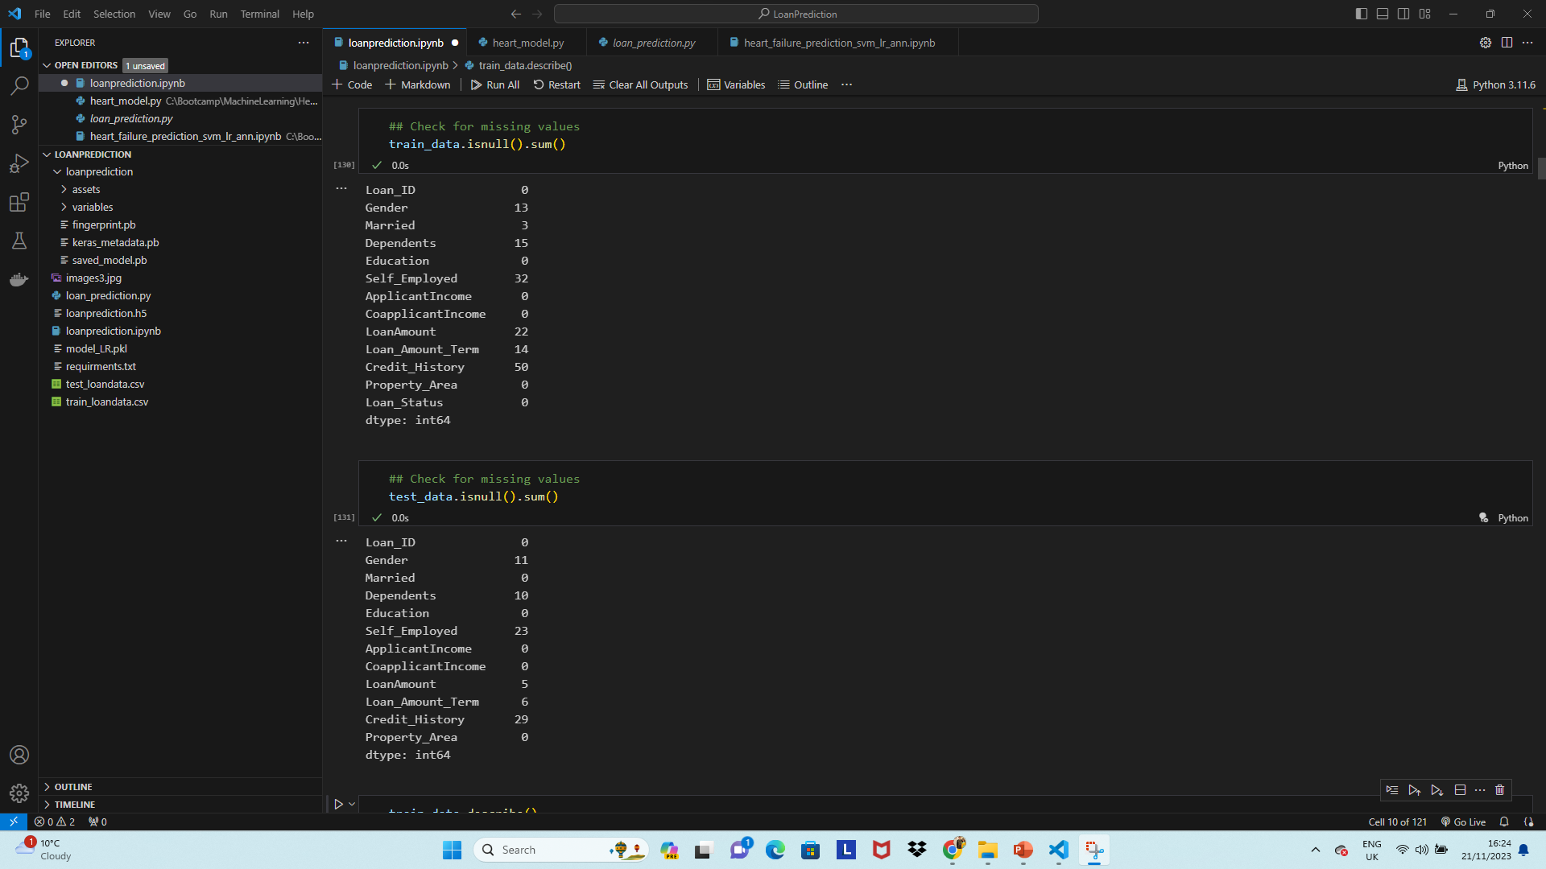
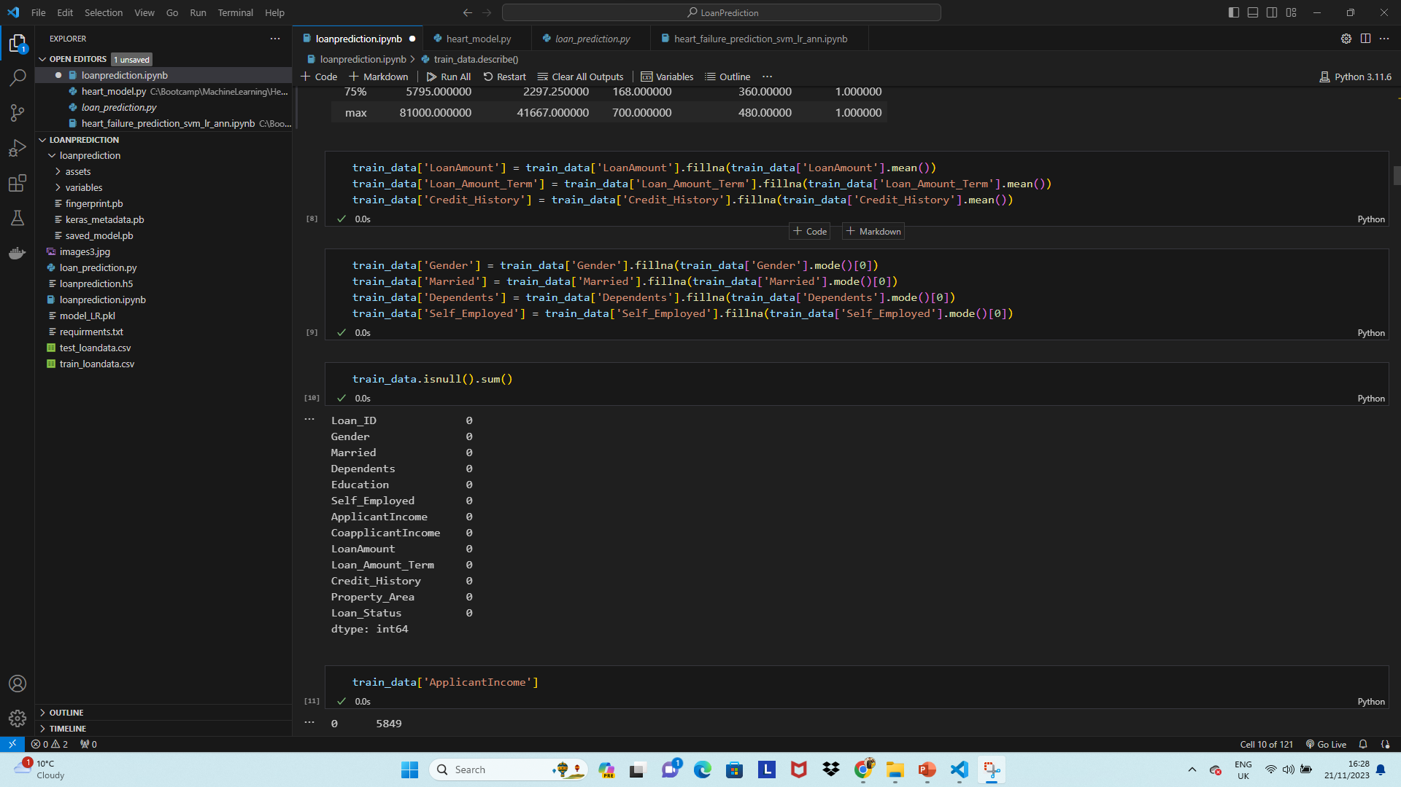
Data Loading & Manipulation
Replace missing values with mean

Slide 9
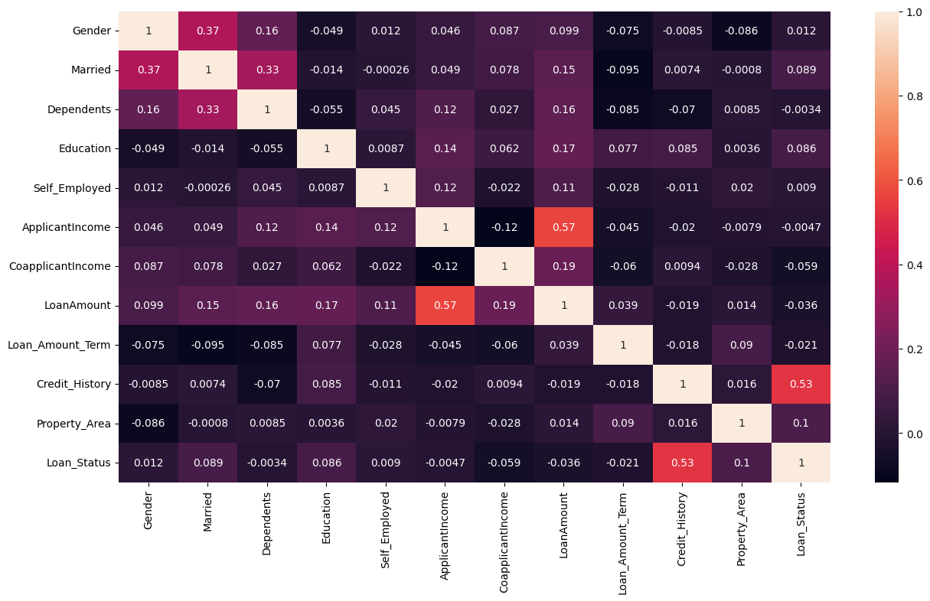
Correlation Matrix Heat Map

Slide 10
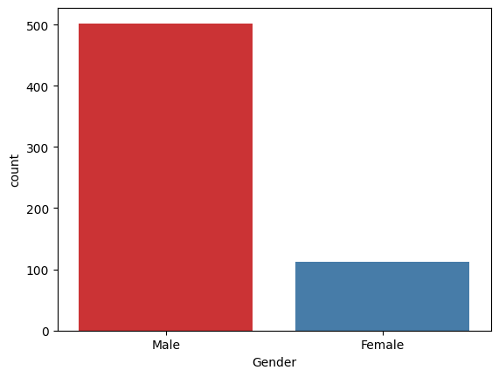
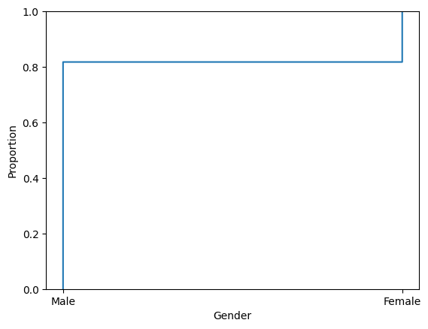
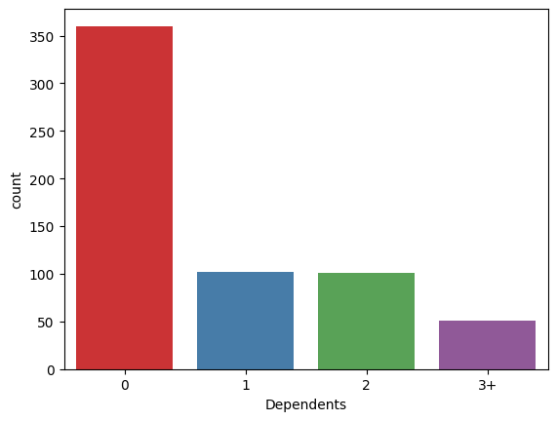
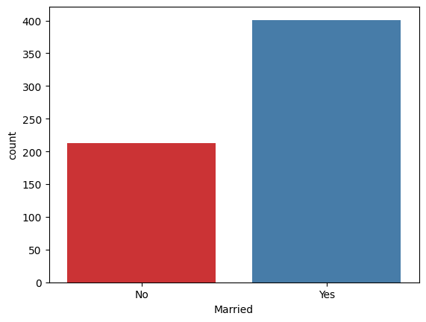
Exploratory Data Visualization

Slide 11
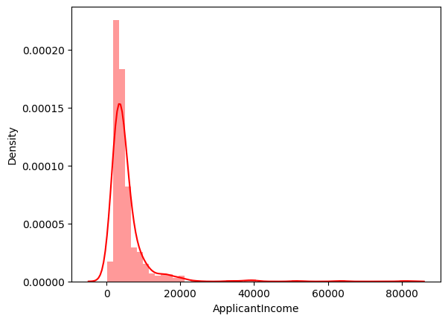
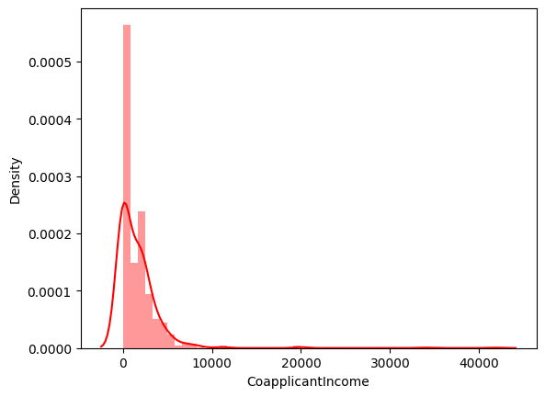
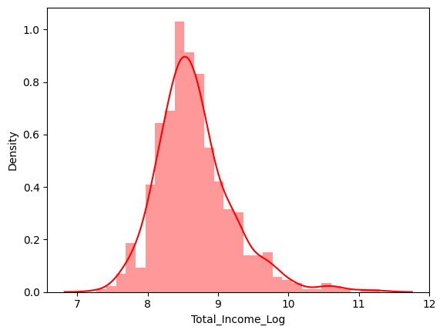
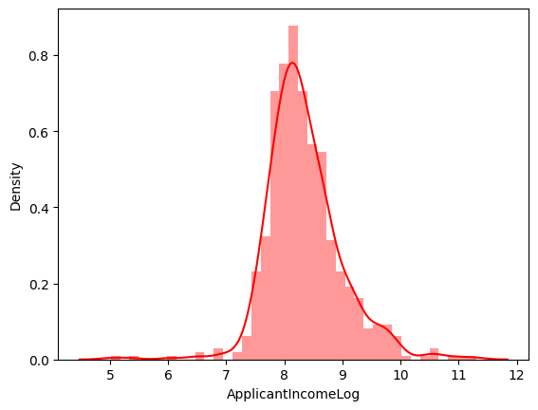
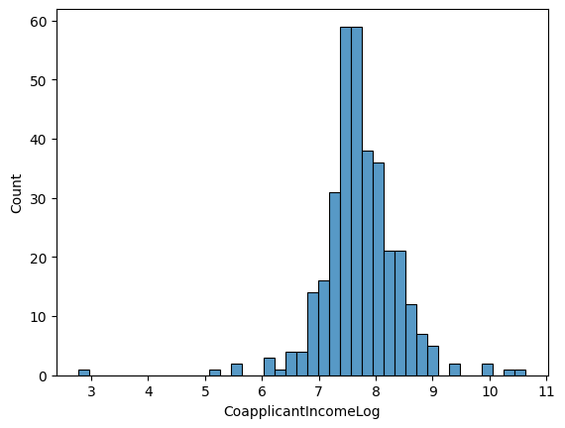
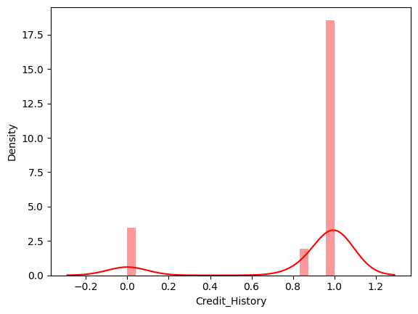
Exploratory Data Visualization

Slide 12







Python Libraries

Slide 13
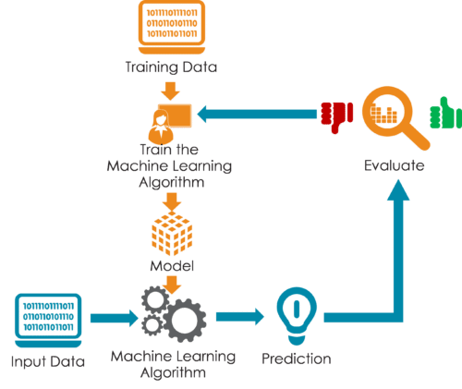
Methodology & Algorithms
Split the dataset
Train the dataset
Compare the Algorithms
Machine Learning Algorithms Tested:
01
02
03
Artificial Neural Network
Logistic Regression
Naïve-Bayes
(Gaussian)
04
05
06
Support Vector Machines
Random Forest
k-Nearest Neighbors

Slide 14
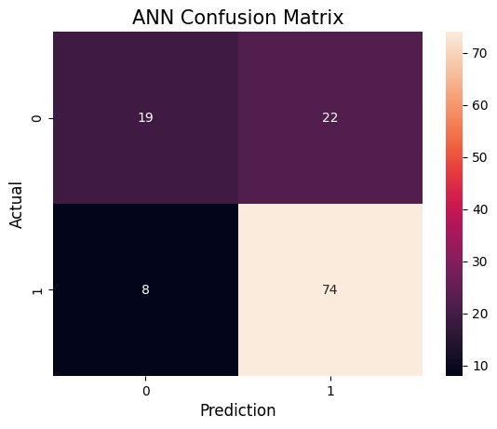
Experiments and Results
Artificial Neural Network (ANN)
The Artificial Neural Network (ANN) correctly predicted the approval of 74 loans, and these loans were indeed approved. Additionally, the model accurately predicted the denial of 19 loans, and these loans were indeed denied.
However, the model also made some errors. It incorrectly predicted that 22 loans would be approved, but in reality, they were denied. This is known as a Type I error or a false alarm.
Furthermore, the model incorrectly predicted the denial of 8 loans, but they were actually approved. This is a Type II error or a miss.

Slide 15
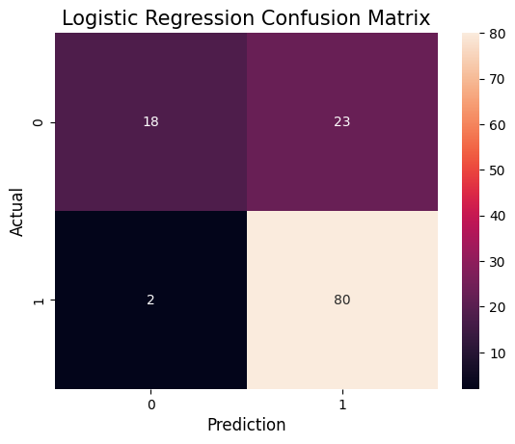
Experiments and Results
Logistic Regression
The Logistic Regression (LR) model accurately predicted the approval of 80 loans, and these loans were indeed approved. Additionally, the model correctly predicted the denial of 18 loans, and these loans were indeed denied.
However, the model also made some errors. It incorrectly predicted that 23 loans would be approved, but in reality, they were denied.
Furthermore, the model incorrectly predicted the denial of 2 loans, but they were actually approved.

Slide 16
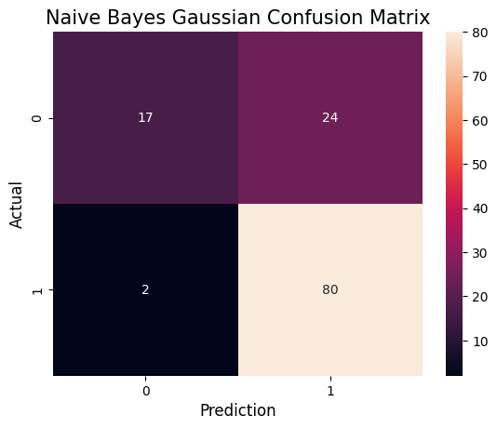
Experiments and Results
Naïve Bayes (Gaussian)
The Naive Bayes (NB) model accurately predicted the approval of 80 loans, and these loans were indeed approved. Additionally, the model correctly predicted the denial of 17 loans, and these loans were indeed denied.
However, the model also made some errors. It incorrectly predicted that 24 loans would be approved, but in reality, they were denied.
Furthermore, the model incorrectly predicted the denial of 2 loans, but they were actually approved.

Slide 17

Experiments and Results
k-Nearest Neighbors (kNN)
The k-Nearest Neighbors (kNN) model accurately predicted the approval of 75 loans, and these loans were indeed approved. Additionally, the model correctly predicted the denial of 20 loans, and these loans were indeed denied.
However, the model also made some errors. It incorrectly predicted that 21 loans would be approved, but in reality, they were denied.
Furthermore, the model incorrectly predicted the denial of 7 loans, but they were actually approved.

Slide 18
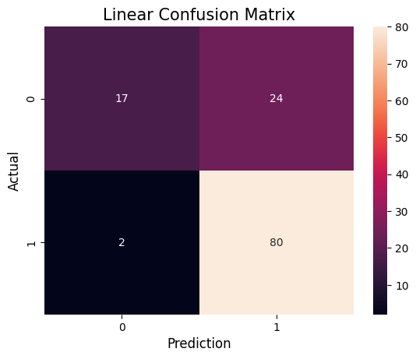


Experiments and Results
Support Vector Machines (SVM)
Linear SVM accurately predicted the approval of 80 loans and the denial of 17 loans. However, there were 26 incorrect classifications, consisting of 24 false approvals and 2 false denials.
Sigmoid SVM correctly predicted the approval of 78 loans and the denial of 17 loans. However, there were 28 incorrect classifications, consisting of with 24 false approvals and 4 false denials.
The RBF SVM accurately predicted the approval of 80 loans and the denial of 17 loans. However, there were 26 incorrect classifications, comprising 24 false approvals and 2 false denials.

Slide 19

Experiments and Results
Random Forest
Random Forest (RF) accurately predicted the approval of 80 loans, and these loans were indeed approved. Additionally, the model correctly predicted the denial of 17 loans, and these loans were indeed denied.
However, the model also made some errors. It incorrectly predicted that 24 loans would be approved, but in reality, they were denied.
Furthermore, the model incorrectly predicted the denial of 2 loans, but they were actually approved.

Slide 20
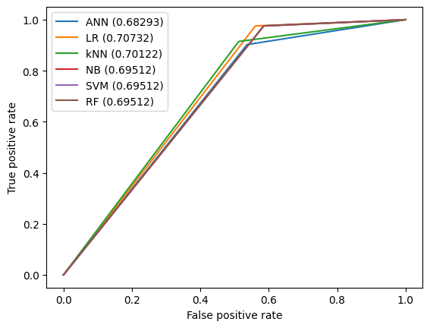
Result Comparison
Algorithms | Precision | Recall | F1 score | Accuracy | AUC
ANN | 0.77 | 0.90 | 0.83 | 0.76 | 0.68
LR | 0.78 | 0.98 | 0.86 | 0.80 | 0.71
kNN | 0.78 | 0.91 | 0.84 | 0.77 | 0.70
NB | 0.77 | 0.98 | 0.86 | 0.79 | 0.69
SVM | 0.77 | 0.98 | 0.86 | 0.79 | 0.69
RF | 0.77 | 0.98 | 0.86 | 0.79 | 0.69

Slide 21
Conclusion
Machine learning algorithms provide a powerful tool for loan prediction, allowing to make more informed decisions about loan approval.
Logistic regression showed better performance than the others with 80% accuracy, while other algorithm got less accuracy than LR.
Streamlit web-application has been created with LR for loan Prediction.

Slide 22

Limitations
Imbalanced Datasets.
Relatively small dataset for any ML algorithms.

Slide 23

Thank u

